Slide 1
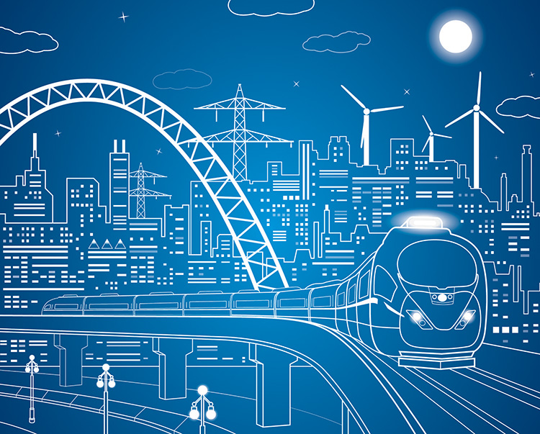
Sustainable Design + Engineering Principles
Notes:
These slides are covered by a Creative Commons license (CC-BY-NC-SA). You are welcome to adopt or adapt these slides for noncommercial purposes, as long as you give credit to the SCU Center for Sustainability, and make your version available on the same terms to others.
Created by: Chad Raphael, SCU Faculty Associate for Sustainability across the Curriculum

Slide 2
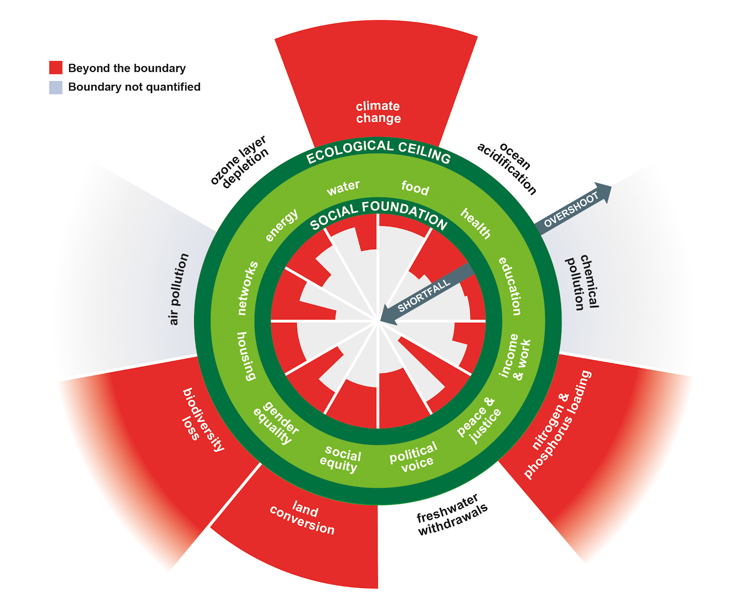
Why Sustainability?
Climate Change
400 ppm CO2 in the atmosphere exceeding the 350 ppm boundary, causing climate change and sea level rise
Food
1 in 9 do not have enough to eat
Water
1 in 11 have no source of safe drinking water
Education
1 in 6 children are not in school
Income
1 in 4 live on less than $3 a day
Biodiversity Loss
Half the number of mammals, birds, reptiles, amphibians, and fish have fallen since 1970
Nitrogen & Phosphorus Loading
Twice the safe level of Nitrogen and Phosphorus in the soil, causing ocean dead zones
Land Conservation
62% of land that can be forested is still a forest
Source: Raworth, 2017
2
Notes:
We need engineers to help heal an unsustainable world

Slide 3
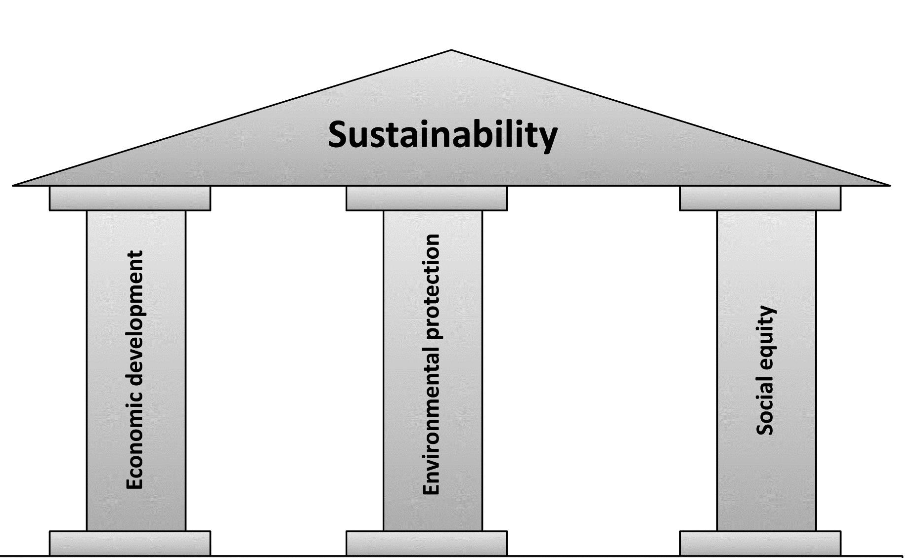
What is Sustainability?
"Development that meets the needs of the present without compromising the ability of future generations to meet their own needs."
- United Nations Brundtland Report (1987)

Slide 4
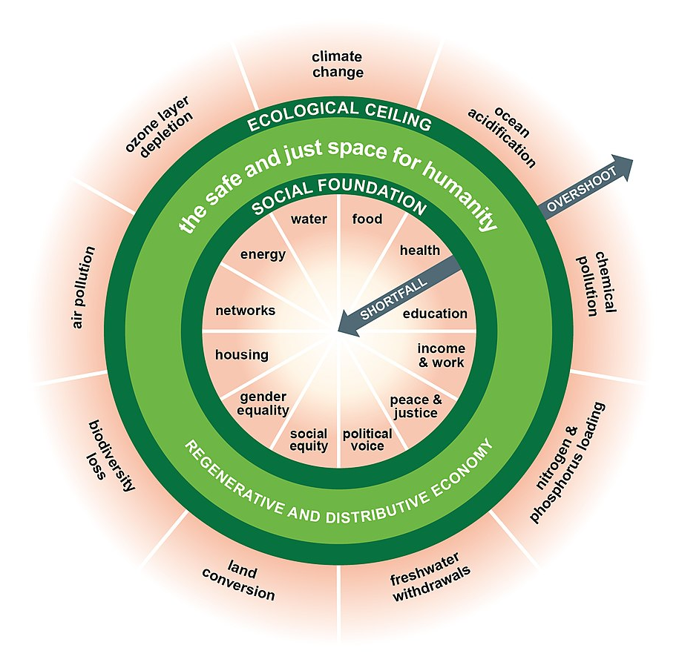
What is Sustainability?
“The doughnut: a 21st century compass. Between its social foundation of human wellbeing and ecological ceiling of planetary pressure lies the safe and just space for humanity.”
Kate Raworth, Doughnut Economics: Seven Ways to Think Like a 21st-Century Economist.
Notes:
Developed by economist Kate Raworth, the sustainability doughnut is more attentive to how sustainability is a space that exists beneath the ceiling of ecological limits to natural resources and above the foundation of social needs for food, water, and other basics of life. It’s envisions an economy that regenerates what it takes from nature and distributes it fairly among humanity.

Slide 5
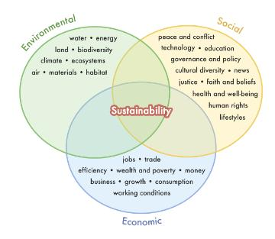
What is Sustainability?
Systems thinking
that addresses each of the three pillars of sustainability

Slide 6
Example Question
How can we design electronics using materials that can be recycled more safely and efficiently?
Notes:
Questions like these address sustainability. Materials are part of the environmental pillar, workplace and community safety (health) are part of the social development pillar, and efficiency is part of the economic pillar.

Slide 7
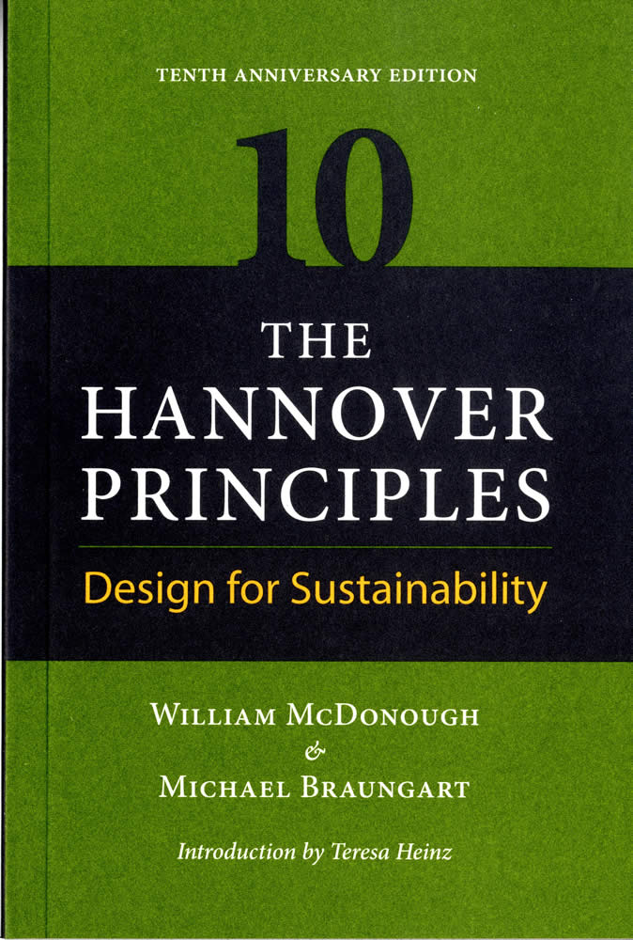
Principles of Sustainable Design
The Hannover Principles + Waste Prevention Strategies
Which of these principles could you apply in your project?
Notes:
See your handout for the Hannover Principles and principles of waste minimization.
Talk with your project partners about which of these principles you could apply in your project.

Slide 8
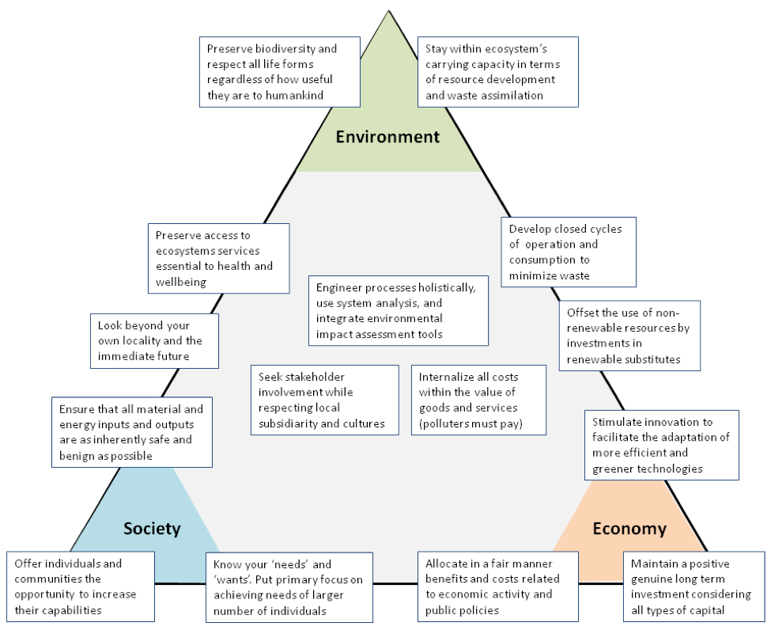
Principles of Sustainable Engineering
Mark Fedkin
Penn State
Which of these principles could you apply in your project?
Notes:
Talk with your project partners about which of these principles you could apply in your project. Try to apply at least one principle that addresses the environment, society, and economy.
This diagram was created by Mark Fedkin of Penn State University’s Dept. of Mechanical and Nuclear Engineering (check out his lesson on this at https://www.e-education.psu.edu/eme807/node/688).
It is adopted from Gagnon, LeDuc, & Savard (2008) "Sustainable development in engineering: a review of principles and definition of a conceptual framework" and from the green engineering principles established by the Sundestin Conference in 2003.

